Slide 1
Agile Data Science
Steve Griswold | Data Science
Galvanize Data Science
September 2018

Slide 2

Overview
Data Gathering
Exploratory Data Analysis
Modeling
Deployment

Slide 3
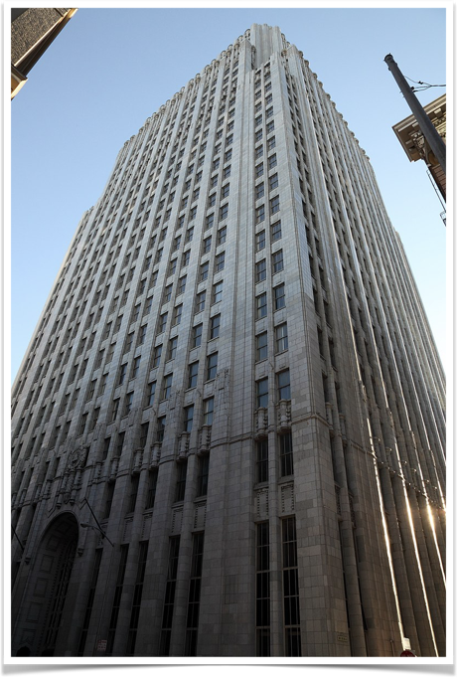
Yelp
Steve Griswold | Data Science
Launched in 2004
Publish Crowd-Sourced Reviews
Revenue - $713 million (2016)
2017 Year End Stats
-141 million unique visitors per month
-148 million reviews
Source: https://en.wikipedia.org/wiki/Yelp

Slide 4
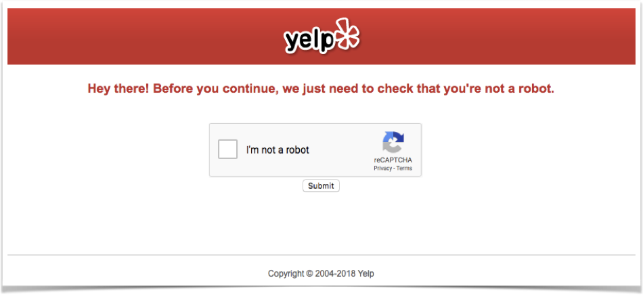
Date Gathering
Steve Griswold | Data Science
Python
Yelp API
Beautiful Soup
aka Web Scrapping

Slide 5
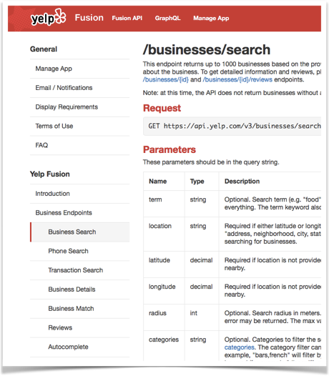
Yelp API
Business Search:
50 per GET
1000 per Location
Reviews
3 Reviews per Business
Truncated to 160 char !

Slide 6
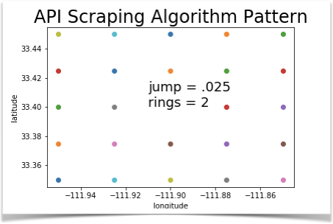
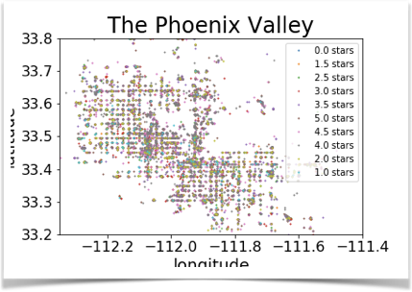




Slide 7

Exploratory Data Analysis (EDA)
Steve Griswold | Data Science
Matplotlib
Pandas
Numpy
Vectorizing
Word Cloud

Slide 8
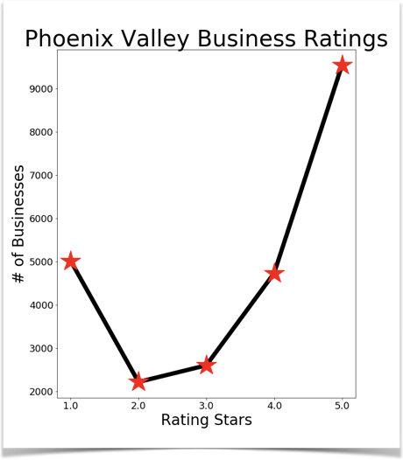
Review Ratings
Why really do reviews?
It was Really Good.
It was Really Bad.
How should I combine?

Slide 9
Average User Review Count
Low frequency
1 Star - Bad
5 Star - Good
Split the Middle
2 Star - Bad
4 Star - Good
Rating | Rating Counts | User Average Number of Reviews
1 | 5018 | 36
2 | 2214 | 110
3 | 2599 | 200
4 | 4733 | 190
5 | 9545 | 81

Slide 10
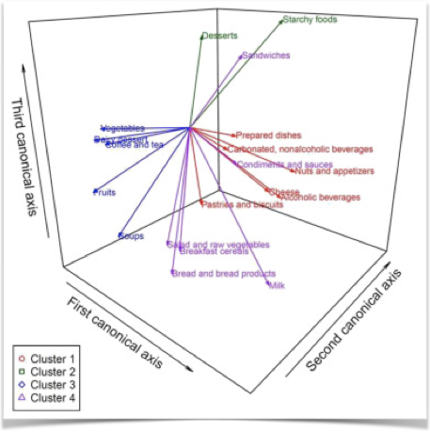
Vectorizing Review Comments
Results
Vocabulary
Word Count
Uses
Word Cloud
Supervised Learning
Clustering
Image from www.nutritionjrnl.com

Slide 11


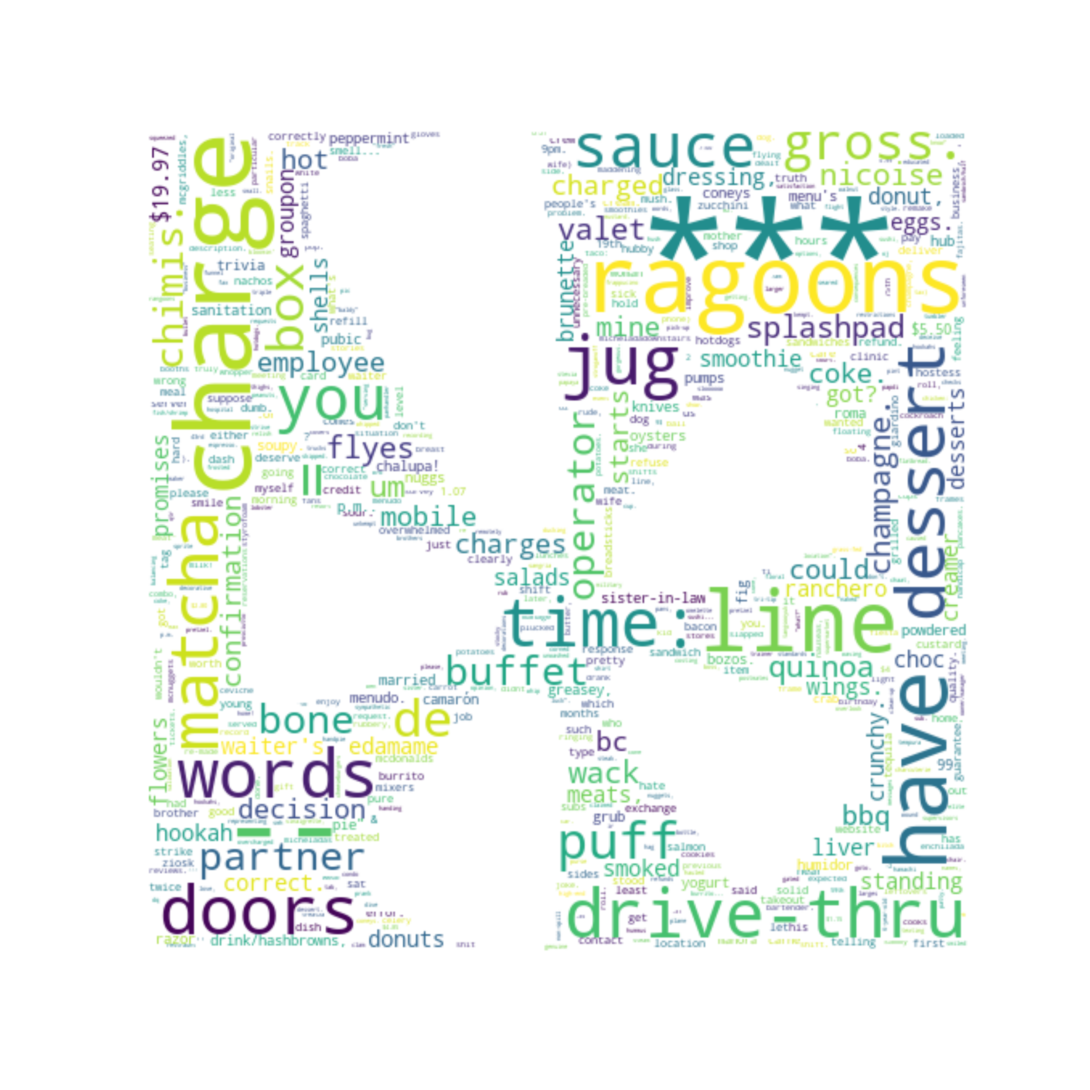
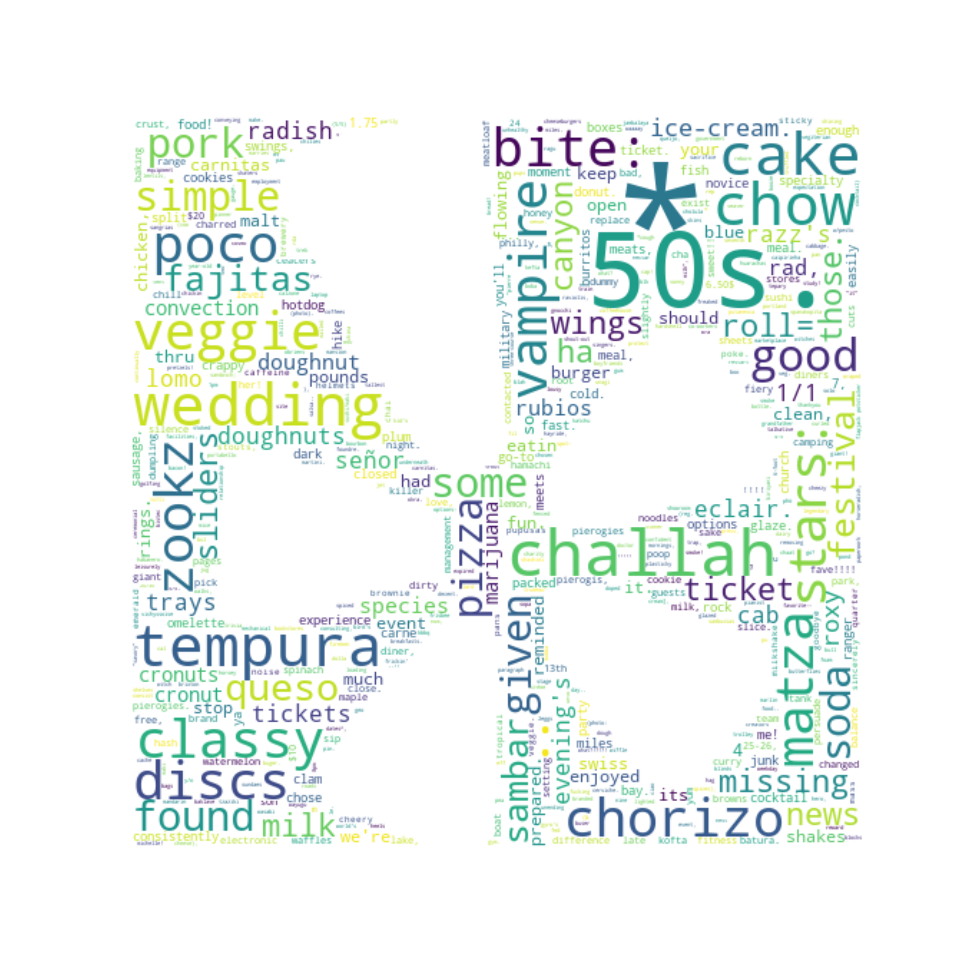

Word Clouds
Words for One Star Ratings
Words for Five Star Ratings

Slide 12
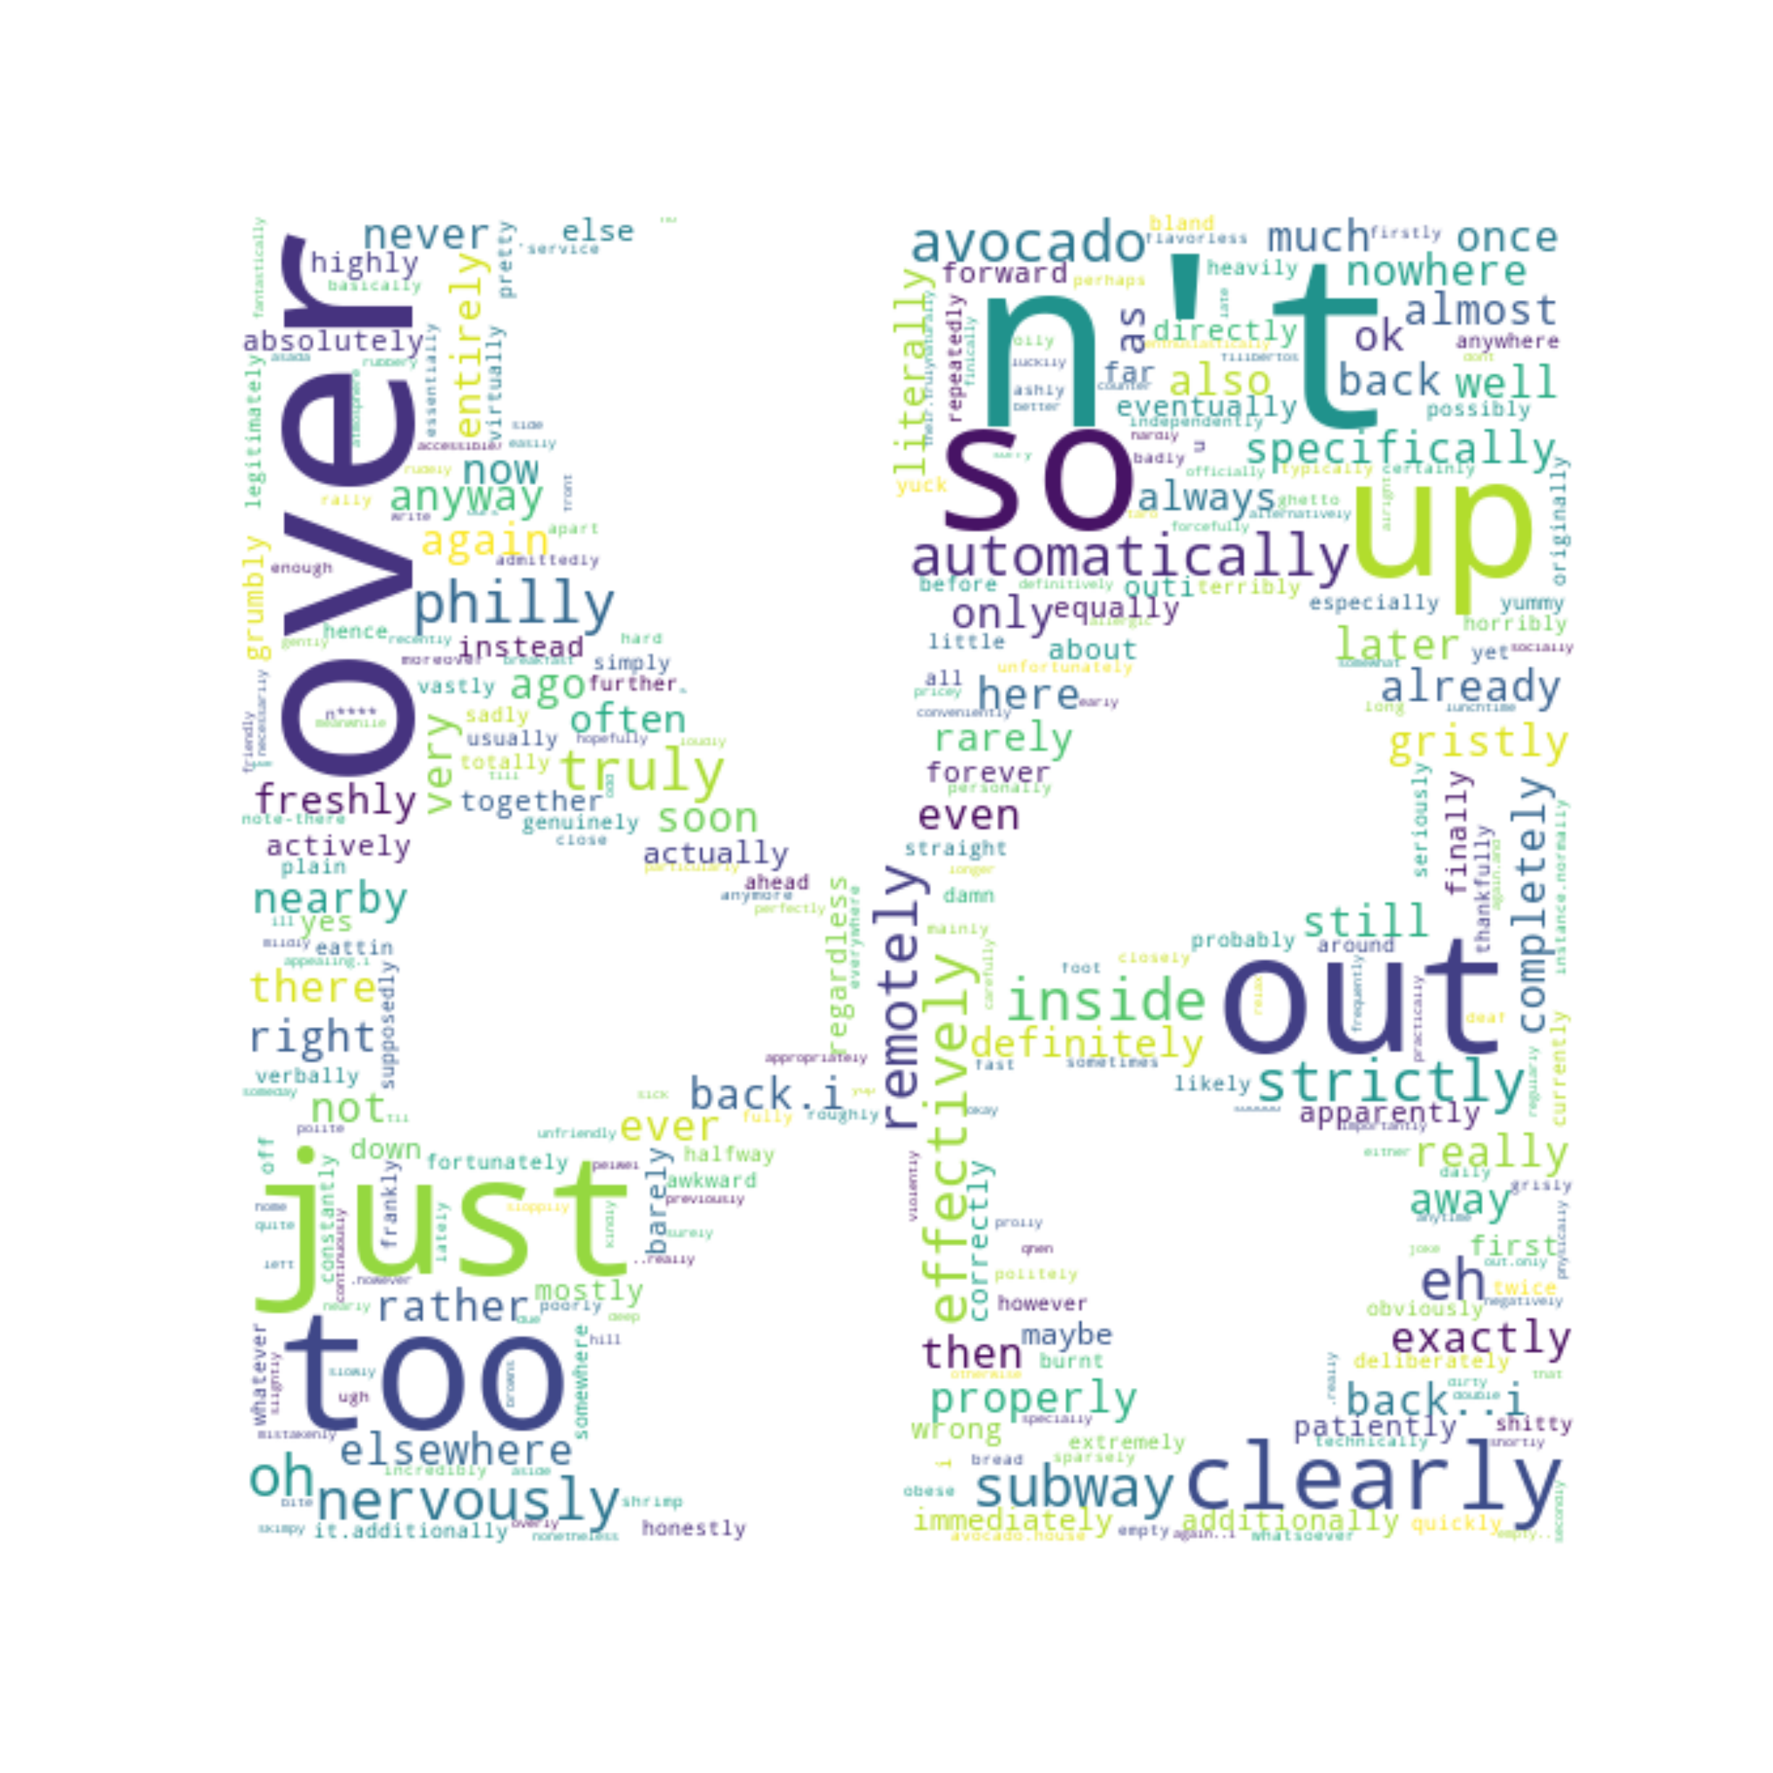
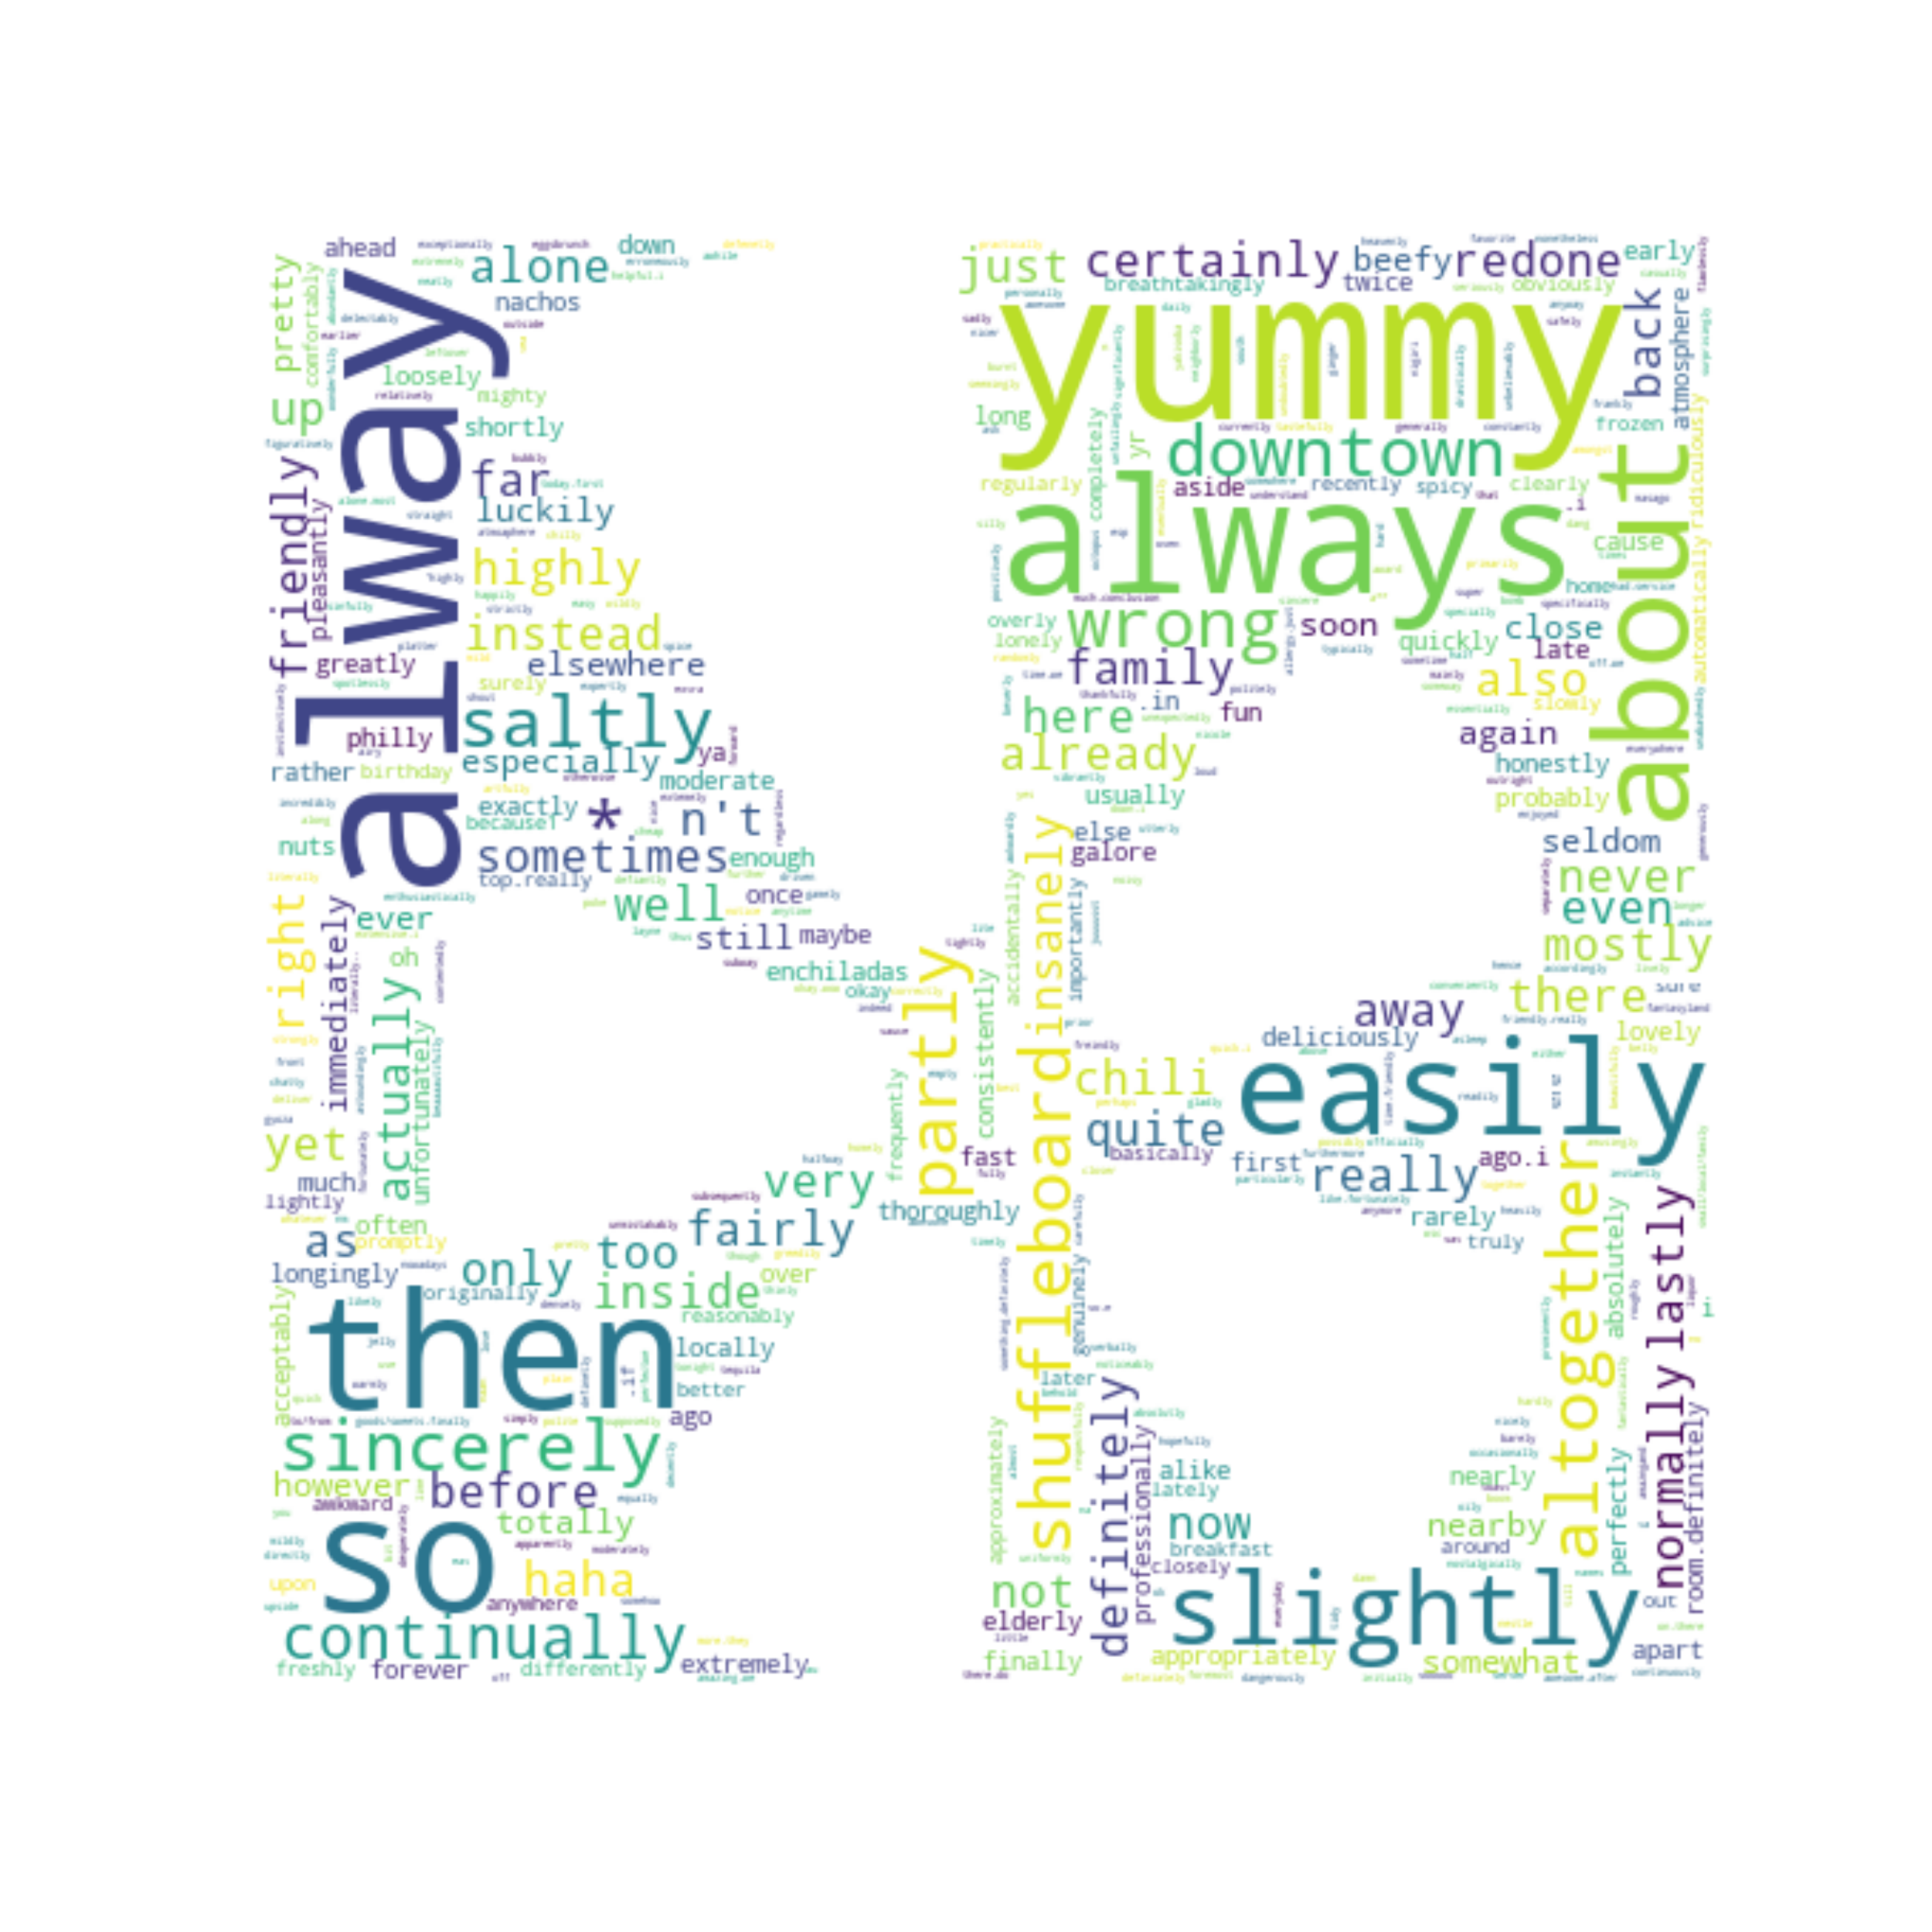
Adverb Word Clouds
One Star Ratings Adverbs
Five Star Ratings Adverbs

Slide 13
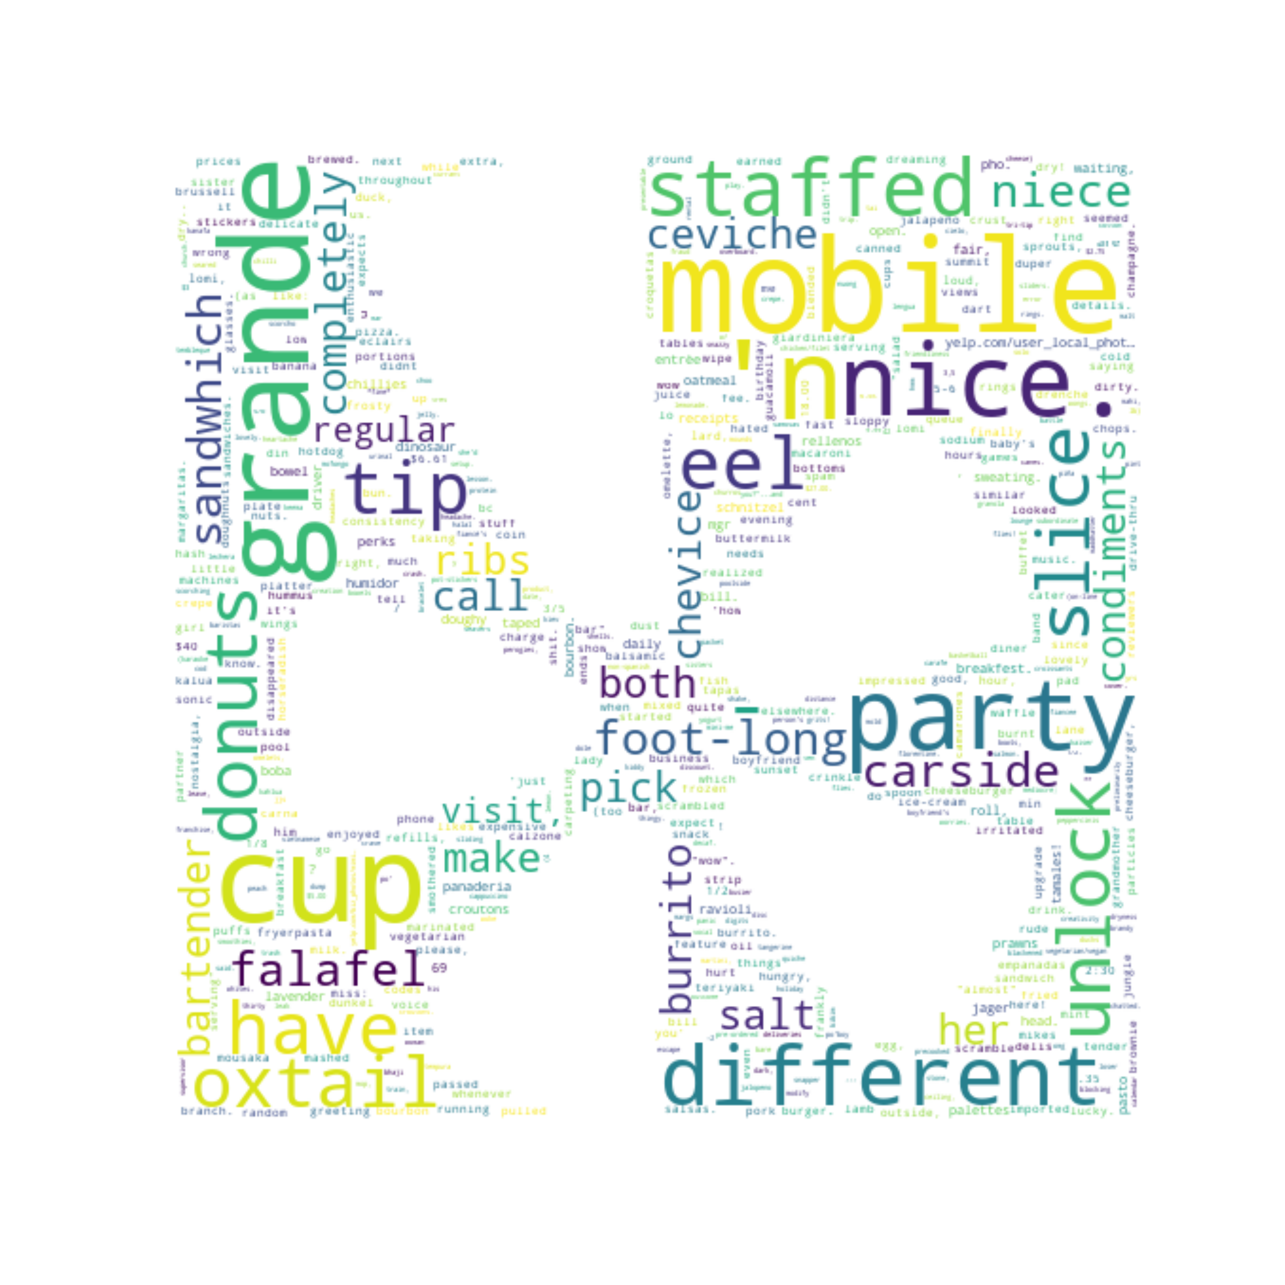
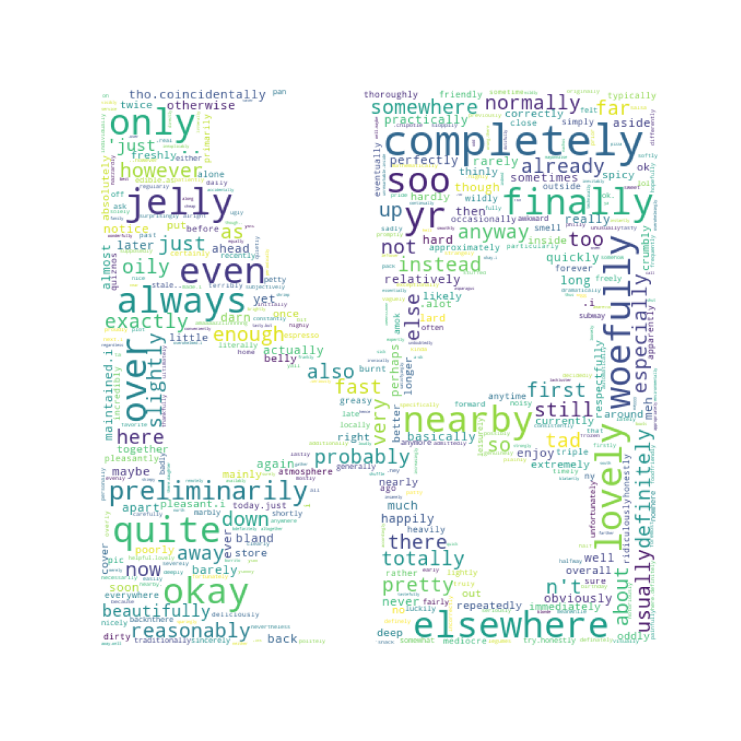
Three Star Reviews
Words
Adverbs

Slide 14

Modeling
Steve Griswold | Data Science
Scikit Learn
Multinomial Naive Bayes
KMeans Clusters

Slide 15

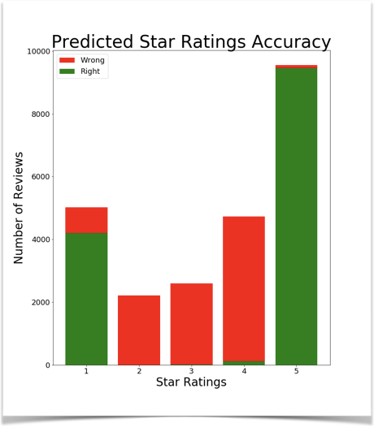
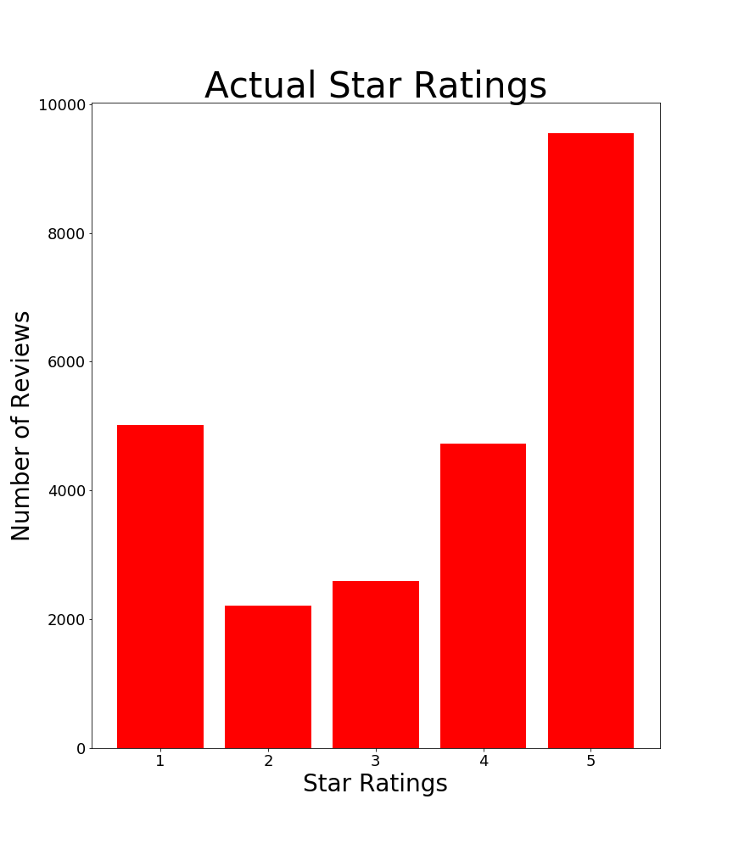
Predicting Review Stars

Slide 16

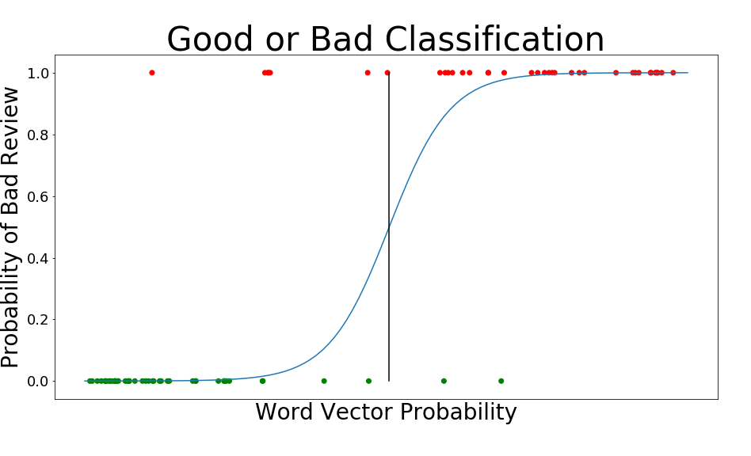
Predicting Good or Bad

Slide 17
KMeans Clustering
Cluster | Centroid Top Feature Words
1 | coffee, donuts, starbucks, iced, milk, shop, drink, like, place, just
2 | order, food, said, minutes, asked, time, manager, service, told, just
3 | tacos, salsa, taco, burrito, mexican, food, good, chips, beans, asada
4 | sandwich, sandwiches, subway, bread, just, like, lunch, cheese, turkey, sub
5 | chicken, good, rice, food, sauce, salad, fried, ordered, like, place
6 | burger, fries, burgers, good, bun, food, cheese, place, like, onion
7 | food, place, good, great, like, service, just, time, restaurant, bar
8 | pizza, crust, wings, order, pizzas, pepperoni, cheese, ordered, time, sauce

Slide 18
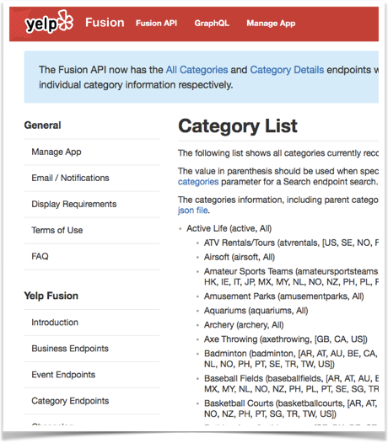
Clusters Replace Yelp Categories
Coffee/Donuts
Breakfast
Lunch/Sandwiches
Dinner
Bar
Park
Long Wait
Good Service
Bad Service
Meat
Burgers
Tacos
Sushi
Salad
Chinese
Pizza
Hot Dogs
Wings
1587

Slide 19
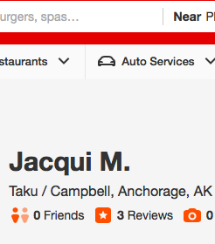
Nearest Neighbors
Location
Latitude
Longitude
Business Rating
Predicted
Good
Bad
Cluster

Slide 20

Application Deployment
Steve Griswold | Data Science
Flask
MongoDB
AWS

Slide 21

Flask: UX
Bootstrap
Javascript
CSS
MongoDB NoSQL Queries
Scale to Need

Slide 22
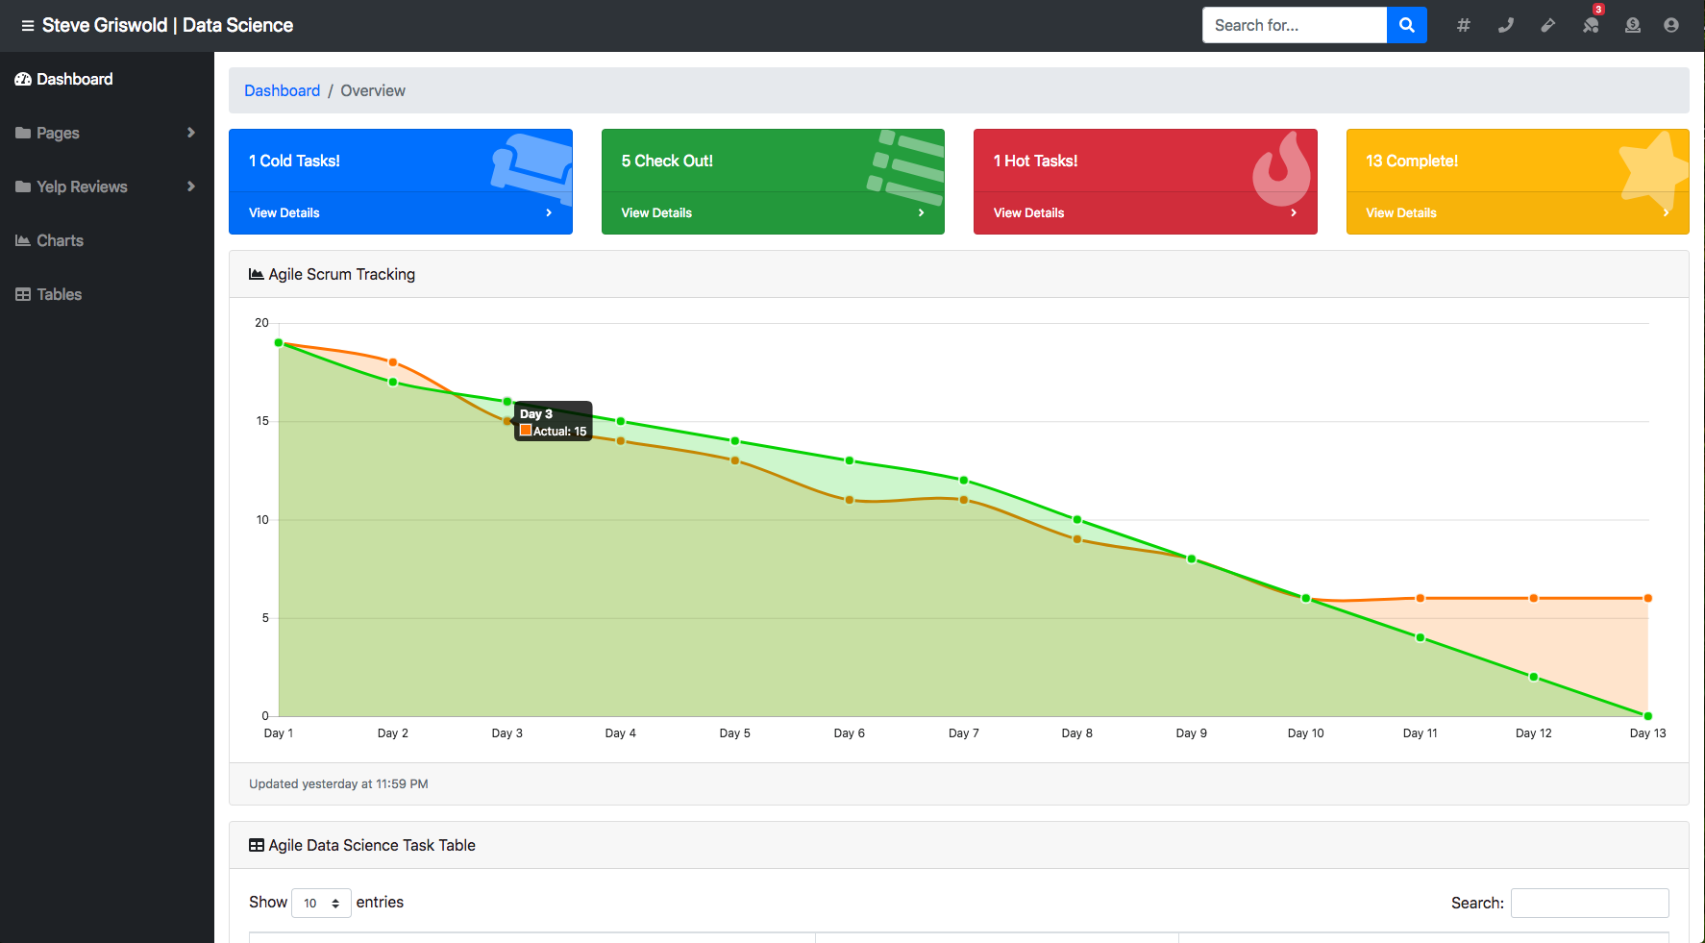

Slide 23




Slide 24


Slide 25

Closing Statements
Steve Griswold | Data Science
Web Scraping: Slow
EDA: Good and Bad
Modeling: Content Based
Deployment: Flask

Slide 26







Tech Used

Slide 27
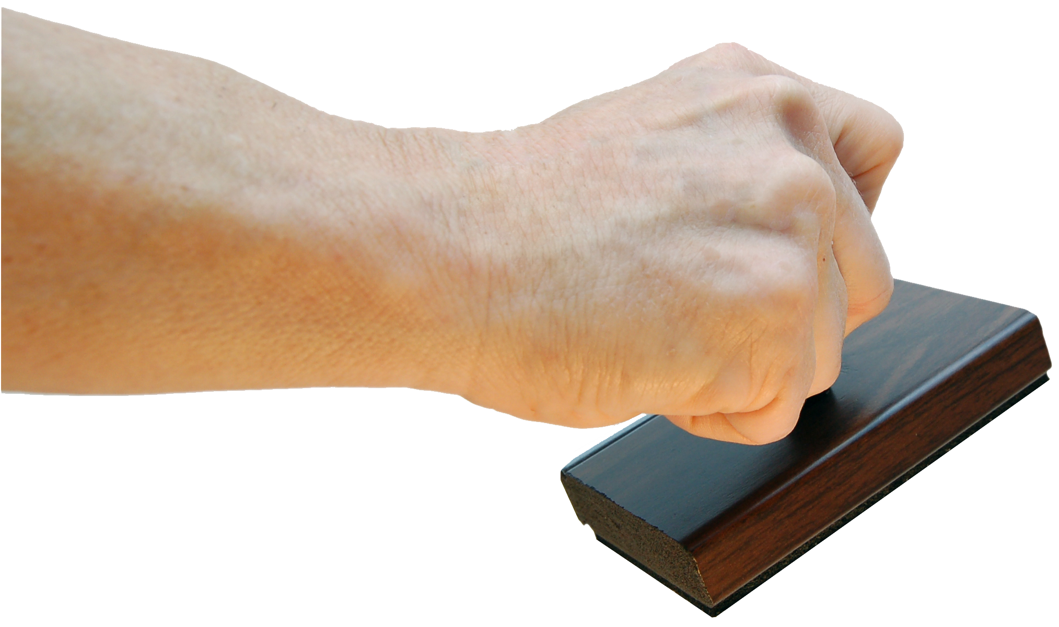
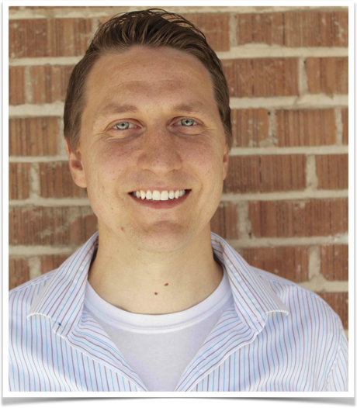

Thank You
Presenter: Steve Griswold
Topic: Yelp - Natural Language
LinkedIn:
https://www.linkedin.com/in/steve-griswold-data-scientist/
GitHub:
https://github.com/SteveGriswold3
Any Questions?

